Slide 1
Evaluating ML algorithm with balanced and unbalanced datasets such as credit card fraud detection.

Slide 2
Credit card fraud detection
What is credit card fraud??
Credit-card fraud is a general term for the unauthorised use of funds in a transaction
How it happens??
Incidents of fraud have been increased significantly in recent years with the rising popularity of online shopping and e-commerce
Detection process
By comparing knn and logistic regression we are going to explore which algorithm and combination of factor provides the most accurate method of classifying a credit card transaction as fraudulent or non fraudulent

Slide 3
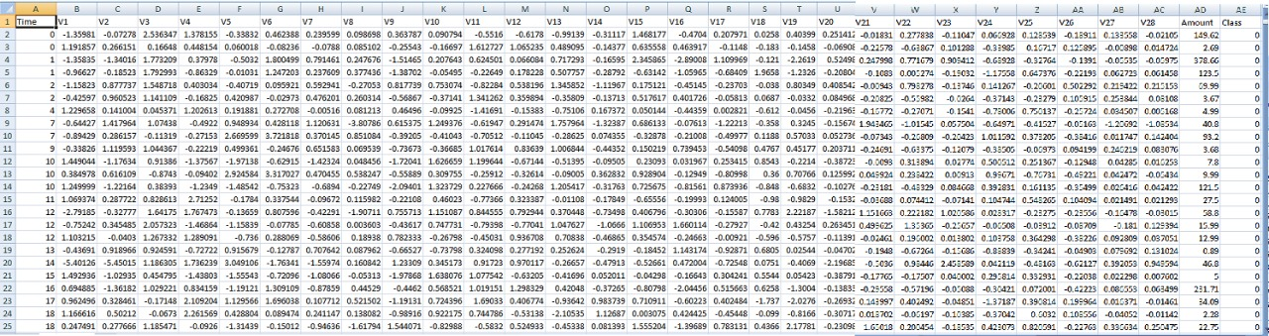
Dataset –credit card fraud detection

Slide 4
K-Nearest Neighbours(KNN)
K Nearest Neighbour algorithm is a clustering algorithm which predicts a data point’s attributes based on its relative position to other data points.
To discover the unknown attribute , or factor , of a testing data point , ts euclidean distance in reference to the every other data point must be found

Slide 5
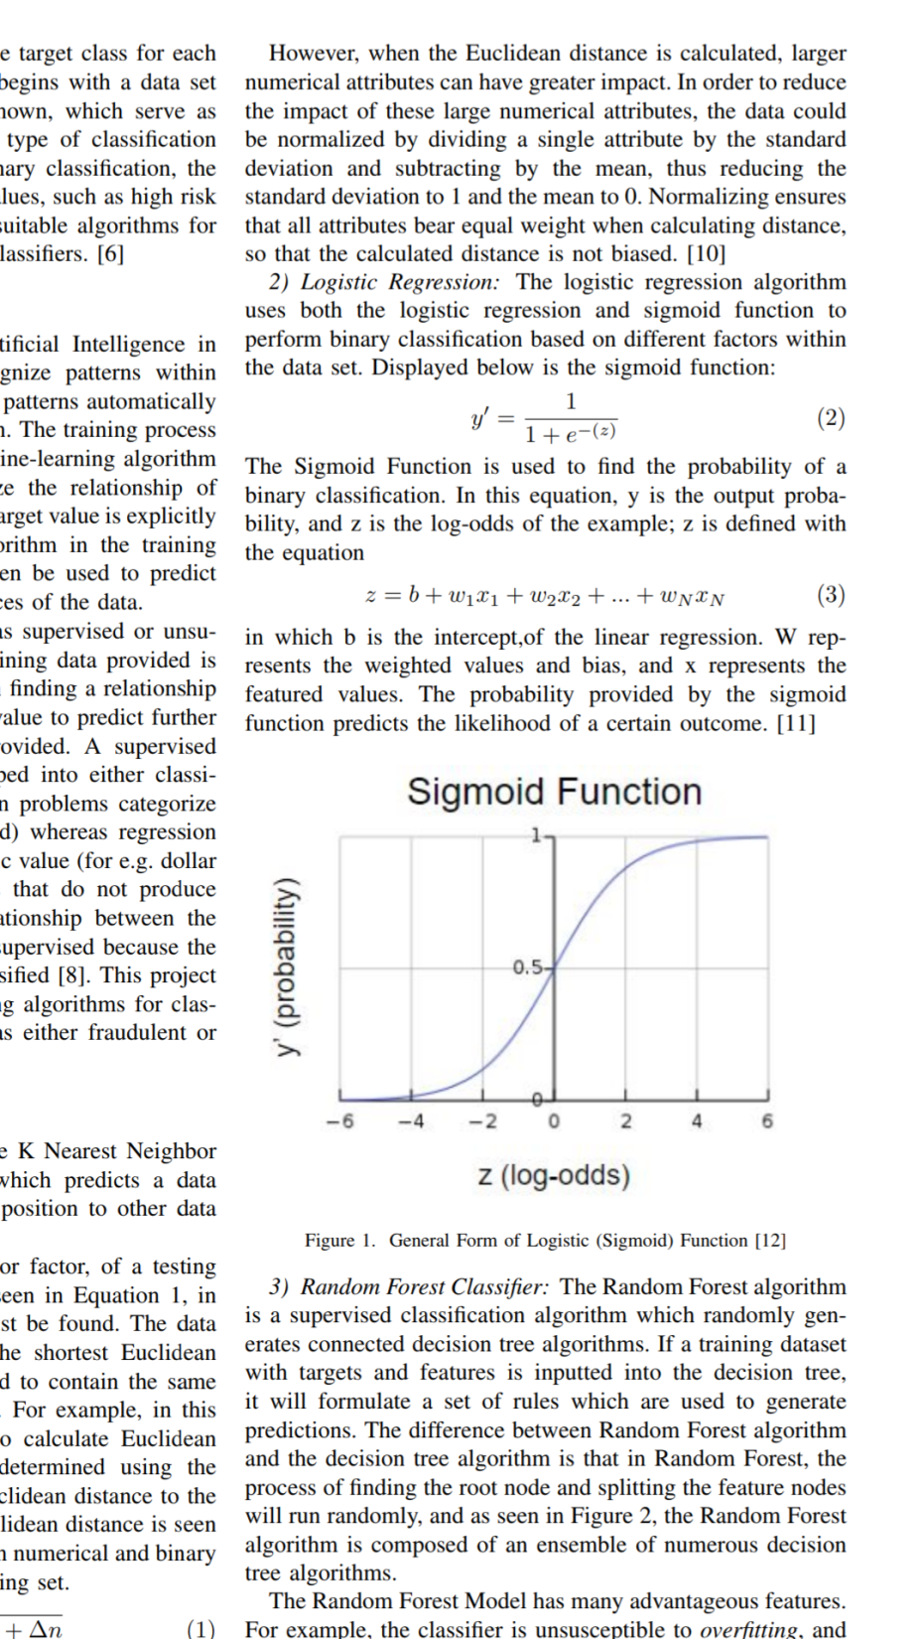
Logistic Regression
Logistic regression algorithm use both logistic regression and sigmoid function to perform binary classification based on different factors within the dataset.
y’=1/(1+e^(z))
The sigmoid function is used to find the probability of a binary classification.

Slide 6
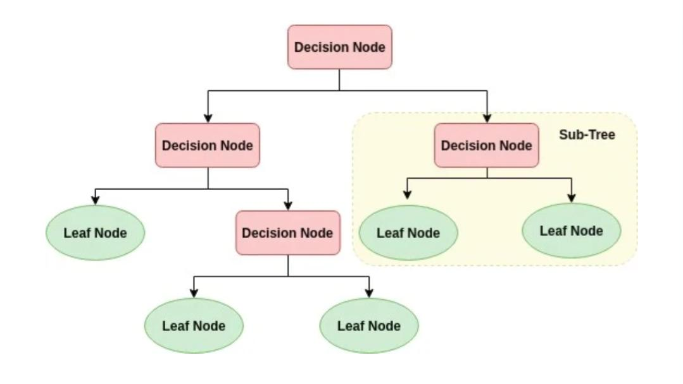
Decision tree

Slide 7
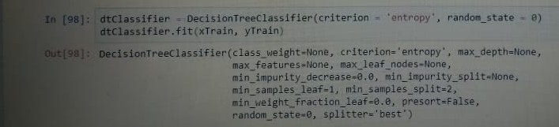
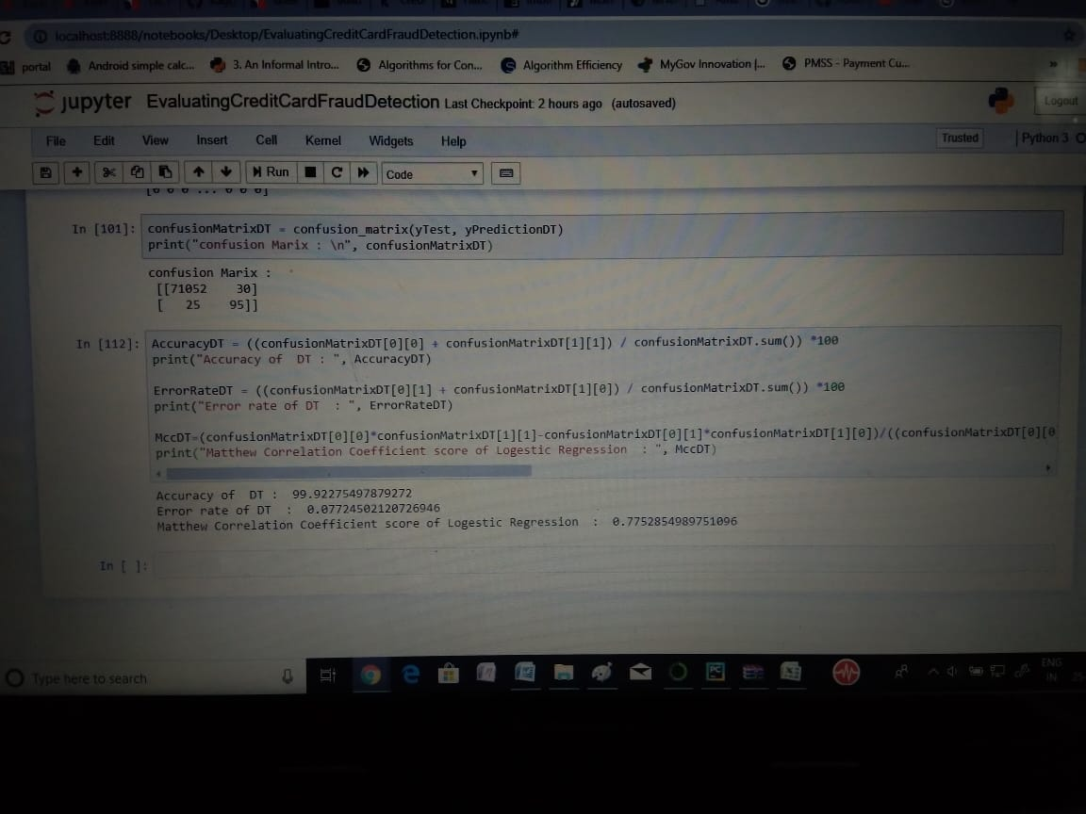
Results.

Slide 8
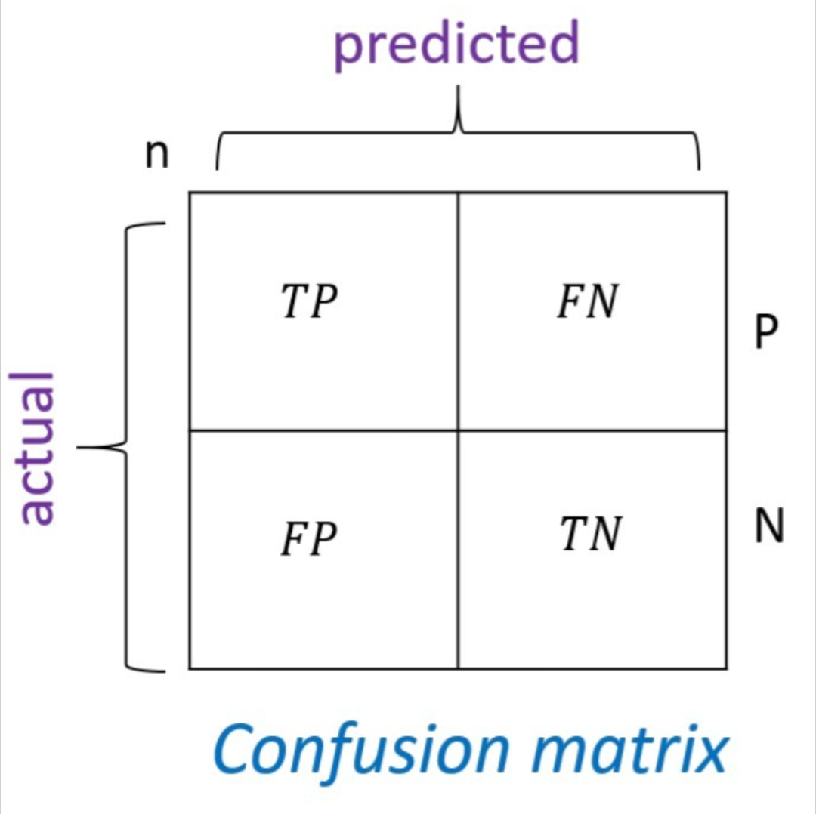
Confusion matrix
The quantification of true positives, false positives, false negatives and true negatives was represented by confusion matrix.

Slide 9
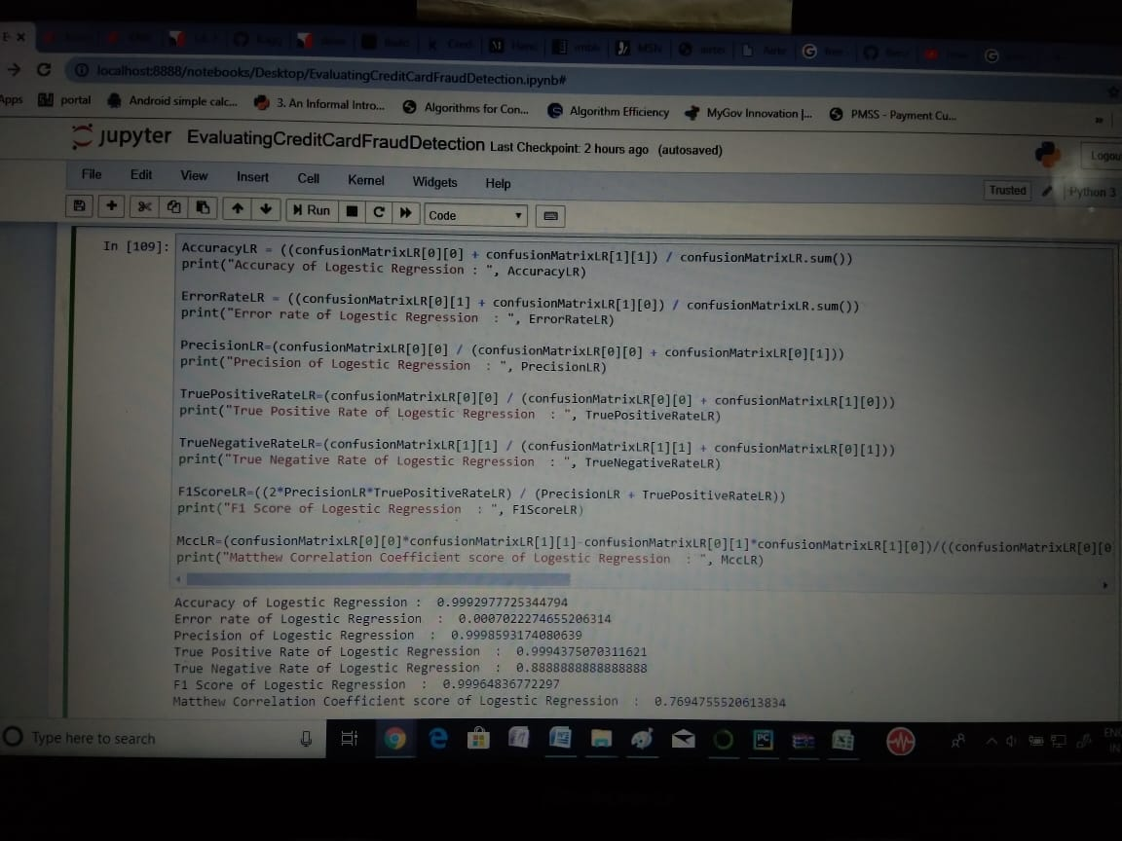
Result.

Slide 10
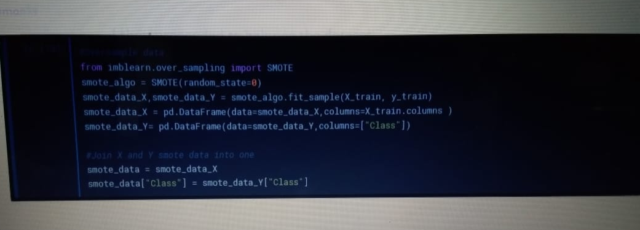
Matthew correlation coefficient score
This is a performance score that takes into account true or false positives, as well as true and false negatives. This score gives a good evaluation for imbalanced dataset .
MCC=(tp*tn-fp*fn)/sqrt((tp+fp)*(fn+tn)*(tp+fn)*(fp+tn))

Slide 11
Methods of handling imbalanced datasets.
Two major methods:
Over sampling
Random
Cluster-based
Synthetic
Modified synthetic
Under sampling
Random

